Slide 1

Parking Spaces as a Security (PBS)
GROUP 8:
Aakash Jeswani A01
Aayush Kamat A04
Arshiyan Sheikh A10
Dhriti Malik A18
Drishty Jain A21
Priyanka Birla A41

Slide 2
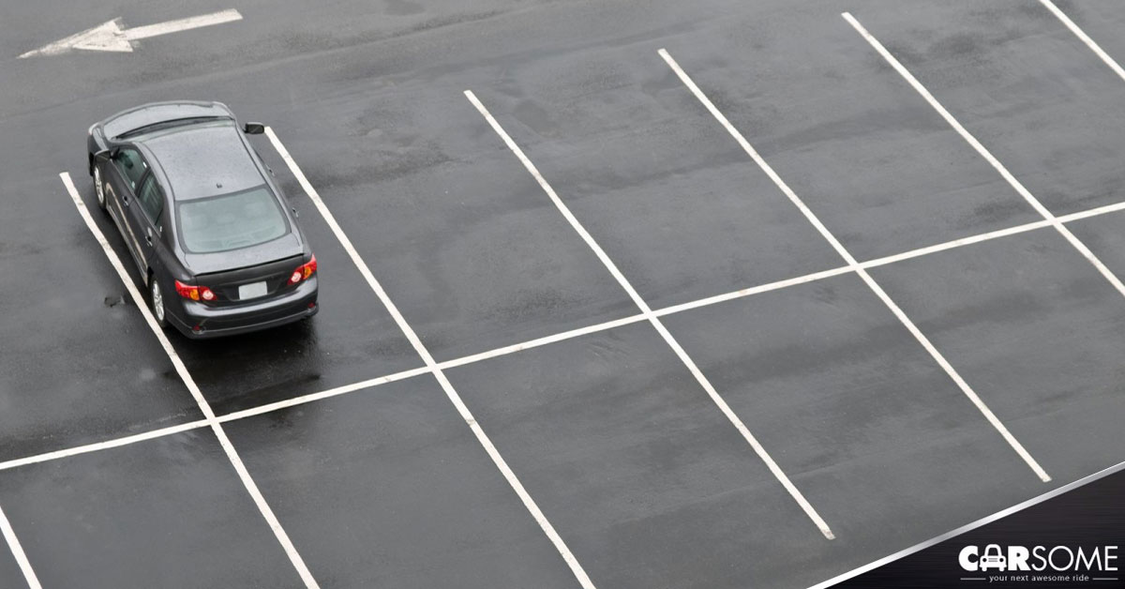
INTRODUCTION
1. Empty unused land of the gov as well as exiting parking spaces owned by gov.
2. The gov builds a parking lot out of unused land.
3. Gives it out as securities to individual investors on the basis of per block of parking space in exchange of a certain amount of money.
4. The interest factor for the investors will be replaced by the receipts earned in the form of pay and park fee.
5. Will last for 1 year, beyond which the private individual investor will have to renew by paying a sum of money to activate another year of the same.

Slide 3

Major Problem:
HOW DID WE COME UP WITH THIS?
Lack of space
Underutilization of unused resources (empty space)
Under-developed parking spaces
Solution:
Increase parking space by benefiting both, the government and the public at large.
09

Slide 4

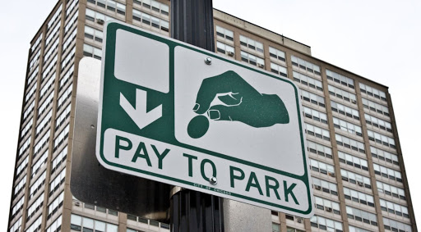
BUSINESS OR REVENUE MODEL
Receipts from parking spaces owned and regulated by BMC and government will be used as collateral.
On purchase of the security, the investor will have rights to a part of the receipts from "Pay and Park" and at the end of the period, his principal will be redeemed.
Expenses will be redundant using economies of scale. Prices will be decided using income approach on the cash flows.

Slide 5
}
TYPES
Category A
Category ‘A’ will be the most crowded with major footfall commercial areas (These are locations like BKC, Nariman Point etc).
TWO-WHEELER
Category B
Category ‘B’ will be comparative moderate crowd and will have general offices and other commercial locations.
FOUR-WHEELER
PBS MODEL
Category C
Category ‘C’ will be the lowest crowded commercial areas.

Slide 6
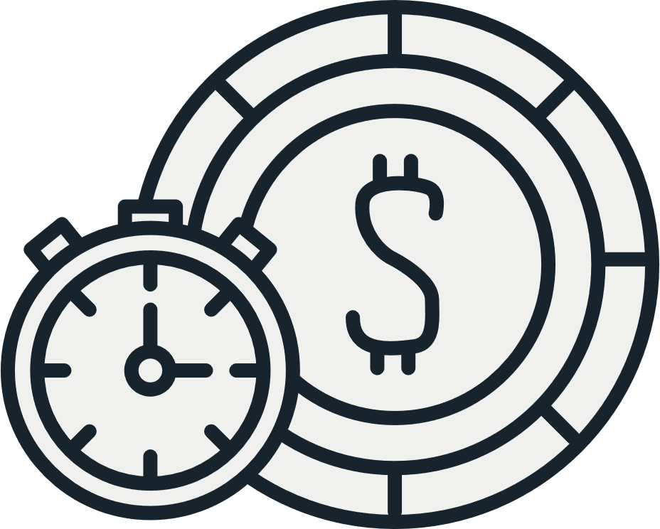
CAR-PARKING CHARGES
Car Parking Duration | Charges
 | A Zone | B Zone | C Zone
Upto 60 Minutes (1 Hour) | Rs.70 | Rs.45 | Rs.25
1 to 3 Hours | Rs.85 | Rs.55 | Rs.30
3 to 6 Hours | Rs.120 | Rs.80 | Rs.40
6 to 12 Hours | Rs.200 | Rs.135 | Rs.70
After 12 Hours | Rs.235 | Rs.155 | Rs.80

Slide 7
BIKE-PARKING CHARGES
Bike Parking Duration | Charges
 | A Zone | B Zone | C Zone
Upto 60 Minutes (1 Hour) | Rs.20 | Rs.15 | Rs.10
1 to 3 Hours | Rs.50 | Rs.35 | Rs.20
3 to 6 Hours | Rs.70 | Rs.45 | Rs.25
6 to 12 Hours | Rs.85 | Rs.55 | Rs.30
After 12 Hours | Rs.100 | Rs.70 | Rs.35

Slide 8

HOW IS THIS INSTRUMENT DIFFERENT FROM OTHERS?
1
Higher interest than a Fixed Deposit
2
Revenue backed, not Asset backed
3
Government guaranteed safety

Slide 9
Diversified Investment Portfolio as there are 6 types
4
HOW IS THIS INSTRUMENT DIFFERENT FROM OTHERS?
5
Lock in Period is 1 Year
6
Lesser regulations required as non-tradable

Slide 10
ADVANTAGES
Securities can be layered into different tranches with different risks
1
2
Lesser lock-in period relieves restrictions
Higher interest than fixed deposits makes it an attractive investment
3

Slide 11
ADVANTAGES
Ideal choice for risk free investments
4
5
Conversion of empty spaces will have environmental benefits
No / very minimal maintenance cost
6

Slide 12
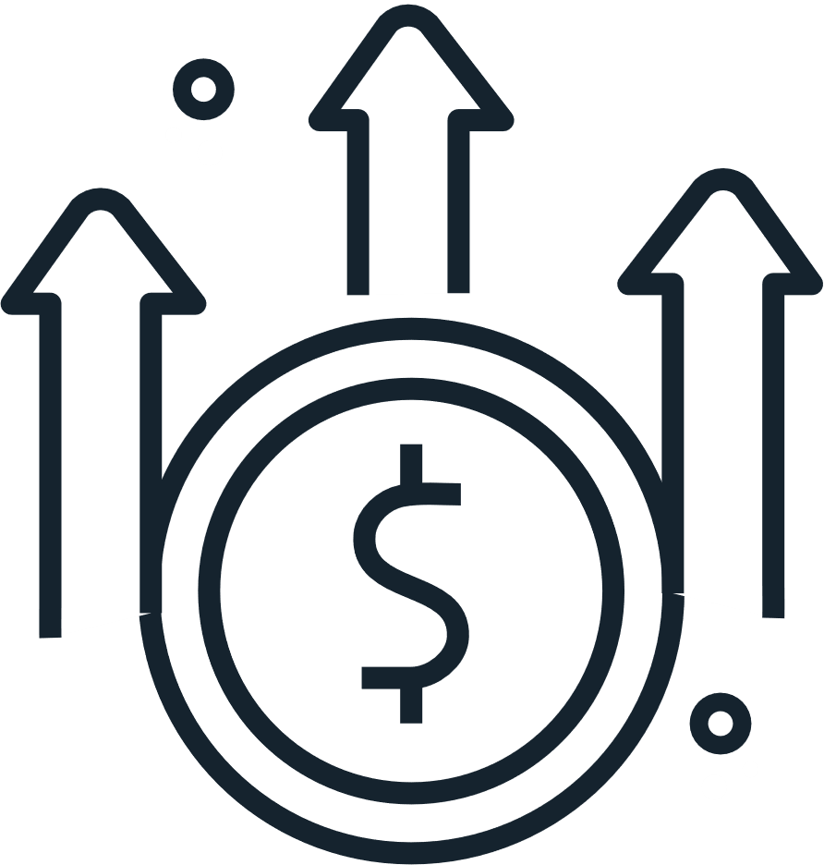
ADVANTAGES
Reduced regulations can help generate efficiency
7
8
Better alternative for government compared to taking up debt
No demolition cost in case land needs to be used for another purpose
9

Slide 13


DISADVANTAGES
FOR THE GOVERNMENT
The charges or expenses to tow the vehicle and other unforeseen expenses can lead to the government making an overall loss.
1
2
It is not completely risk free as pandemics can reduce the need for parking.
Existence of free parking spaces pose a threat to this model.
3

Slide 14

Risk of losing the money invested due to unforeseen circumstances such as pandemics or irregular expenses.
1
2
Losing time value of money.
3
Lock-in period.
DISADVANTAGES
FOR THE INVESTORS

Slide 15
Charges or unforeseen expense
Increasing parking rates for a certain period of time to compensate for the loss. Make use of the money earned by other investments.
Not completely risk free
Taking insurance against theft, etc.
Competition
Free parking spaces are relatively less as compared to pay and park.
PREVENT LIMITATIONS
For Government

Slide 16
PREVENT LIMITATIONS
For Investors
Risk: Risk is minimal in this security as compared to other securities. Government should take steps to ensure against accidents.
1
2
Time-Value of Money: Investors must make sure to gather full knowledge in investing so that they can use the money in a better way.
Lock-in period: After the security is successful for a while, the government can make it tradeable.
3

Slide 17
THANK YOU!

